Slide 1
Future Growth Plan

Slide 2
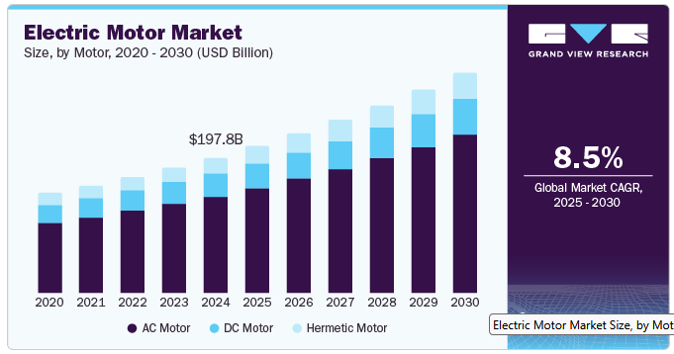
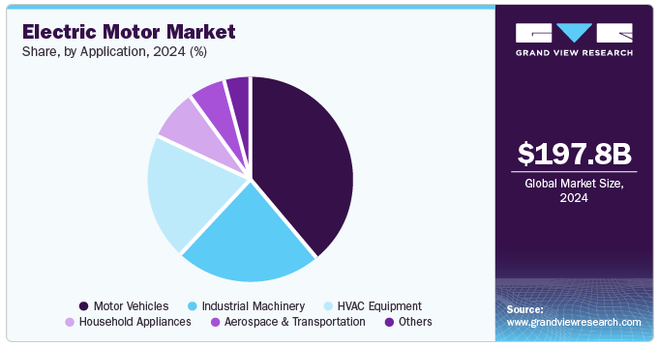
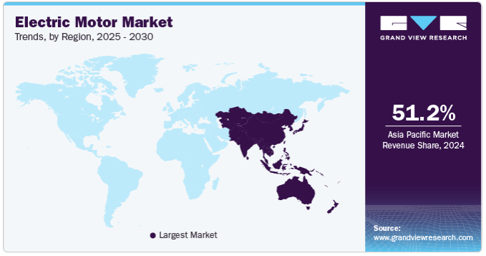
Worldwide Electric Motor Market Development
source: https://www.grandviewresearch.com/industry-analysis/electric-motor-market

Slide 3
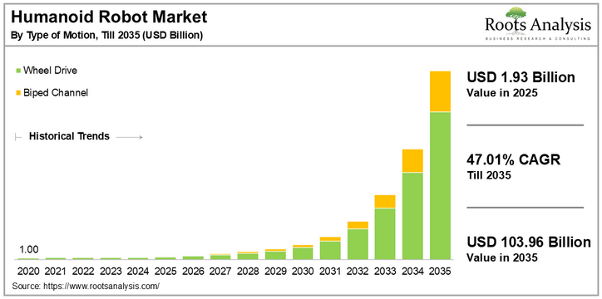
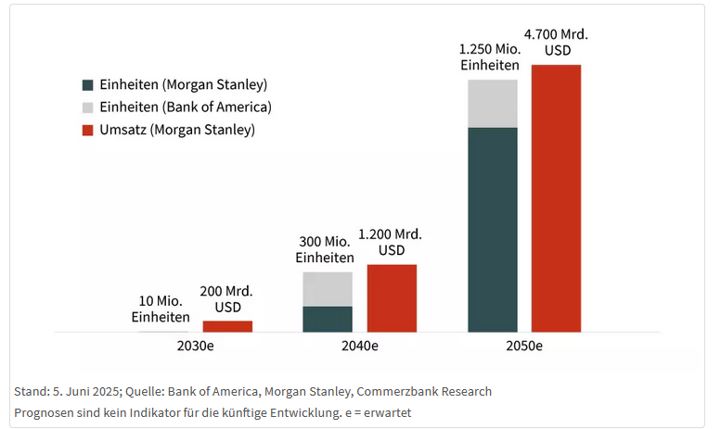
Applications With High Number of Electric Motors
Humanoid Robots
exponential growth
at least 20, up to 100, electric motors per humanoid robot
source: https://www.ideas-magazin.de/2025/ausgabe-279/titelthema/ https://www.maxongroup.de/medias/sys_master/8814479343646.pdf?attachment=true https://www.rootsanalysis.com/humanoid-robot-market

Slide 4
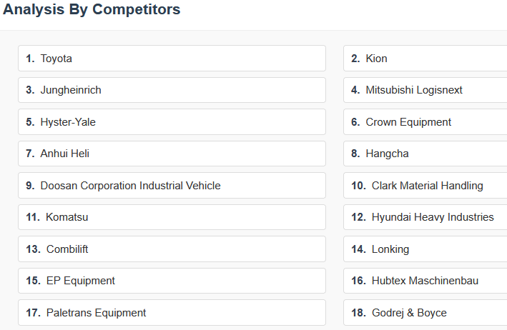
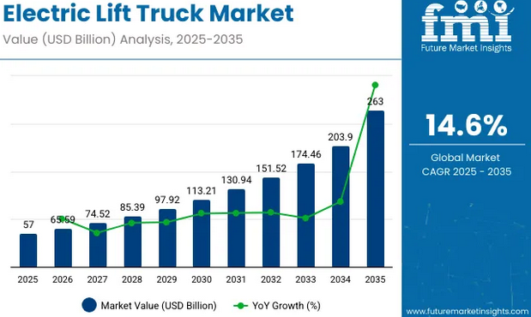
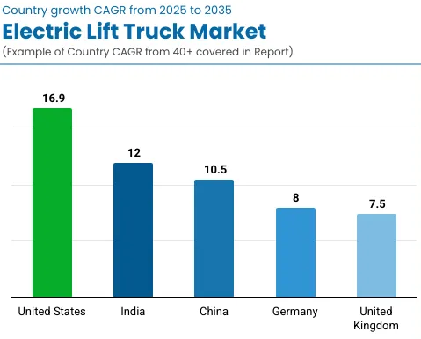
Applications With High Number of Electric Motors
Electric Forklift Trucks
nearly exponential growth
source: https://www.futuremarketinsights.com/reports/electric-lift-trucks-market
https://www.futuremarketreport.com/industry-report/electric-forklift-truck-market

Slide 5
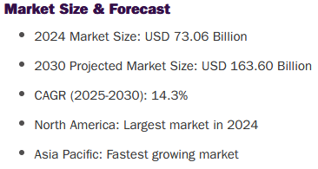
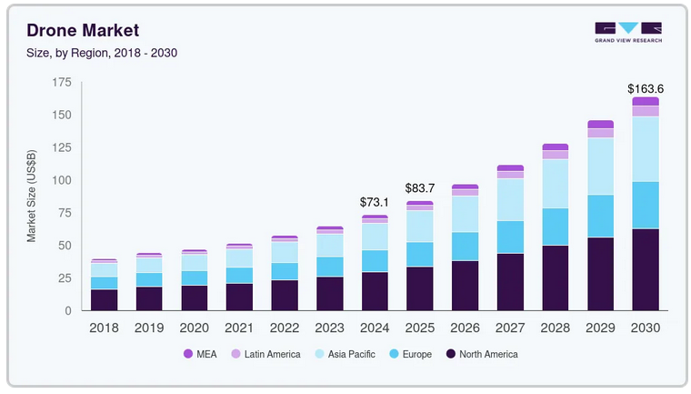
Applications With High Number of Electric Motors
Electric Drones
nearly exponential growth
source: https://www.grandviewresearch.com/industry-analysis/drone-market-report

Slide 6
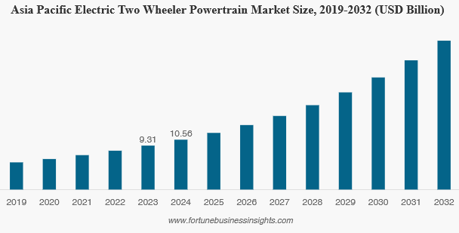
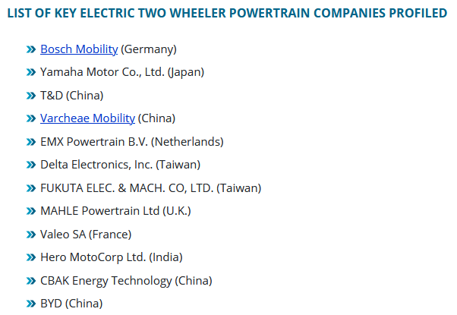
Applications With High Number of Electric Motors
Electric 2-Wheelers
nearly exponential growth
source: https://www.fortunebusinessinsights.com/electric-two-wheeler-powertrain-market-113284

Slide 7
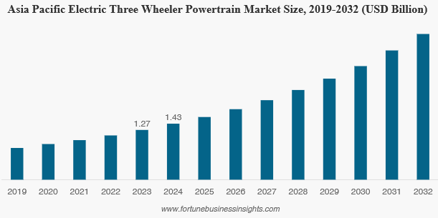
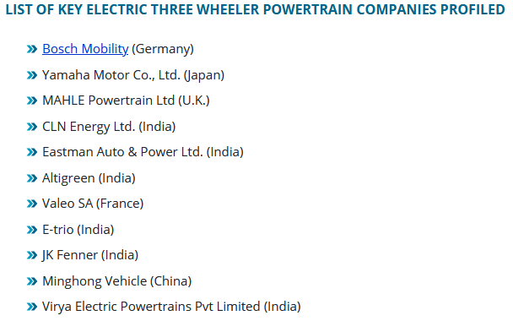
Applications With High Number of Electric Motors
Electric 3-Wheelers
nearly exponential growth
source: https://www.fortunebusinessinsights.com/electric-three-wheeler-powertrain-market-113285

Slide 8
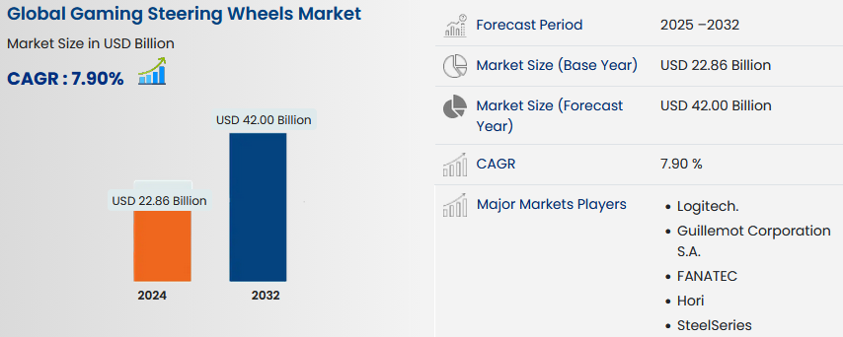
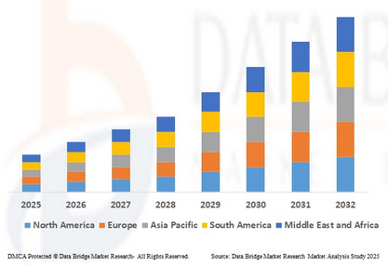
Applications With High Number of Electric Motors
Gaming Steering Wheels
substantial growth
source: https://www.databridgemarketresearch.com/reports/global-gaming-steering-wheels-market

Slide 9
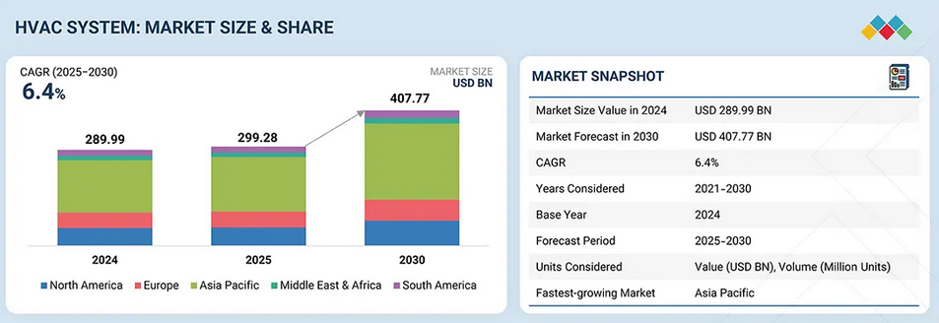
Applications With High Number of Electric Motors
HVAC Systems
substantial growth
source: https://www.marketsandmarkets.com/Market-Reports/hvac-system-market-202111288.html

Slide 10
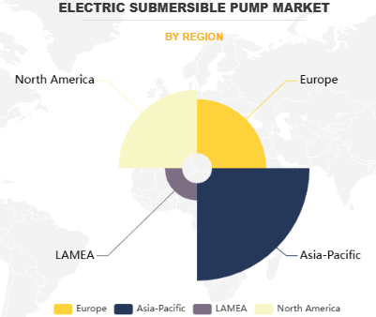
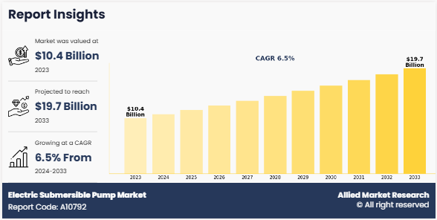
Applications With High Number of Electric Motors
Electric Pumps (example: submersible pumps)
substantial growth
source: https://www.alliedmarketresearch.com/electric-submersible-pump-market-A10792

Slide 11
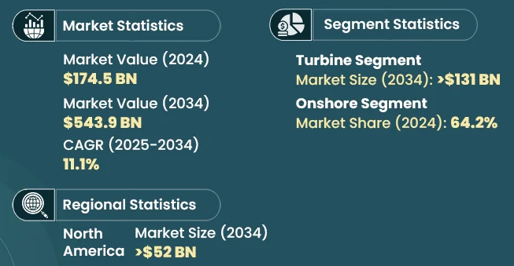
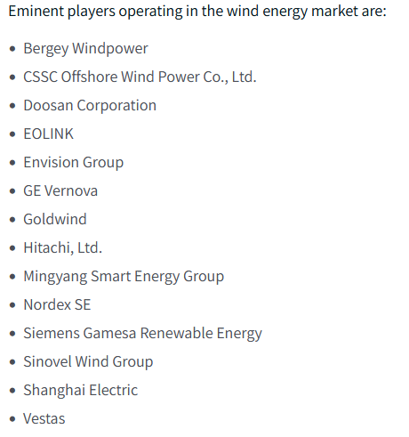
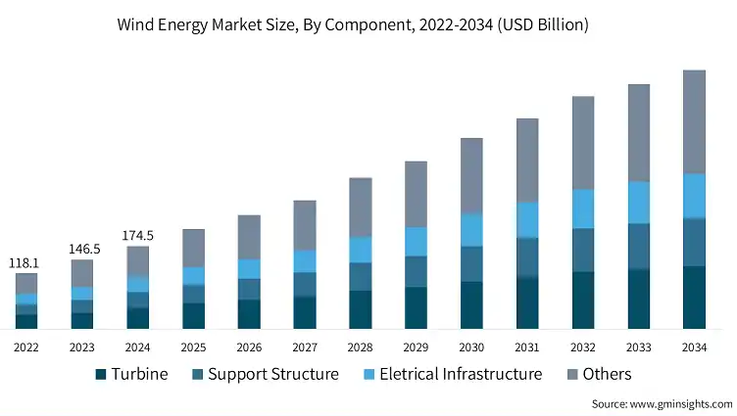
Applications With High Number of Electric Motors
Wind Energy
substantial growth
source: https://www.gminsights.com/industry-analysis/wind-energy-market

Slide 12
Summary: Applications / Markets
No Focus in Automotive
in spite of actual projects with BMW, Rivian, and (hopefully soon) Xiaomi
low margins for suppliers
very long development cycles
destructive competition with well-established suppliers
depending on application: limited growth rate
exception: for special applications / developments
Focus on Permanent-Magnet Motors and Magnet-Free Motors, depending on
world region (e.g. rare-earth magnets in China)
application (requirements sometimes dictate motor topology)
Promising Markets
high growth rate
„new“ applications
always being open to additional potential markets

Slide 13
FEAAM Vision
FEAAM Focal Points
short-term: electric motor development development of special applications control development focus on sale of licenses (increasing income via license fees)
mid-term: gear-box expertise power electronics expertise service delivery of complete drive systems
long-term: gear-box development ??? power electronics development ??? production ???
Target: FEAAM as „Hidden Champion“
in terms of components for applications (see humanoid robot)
in terms of knowledge to the public
NOT in terms of knowledge to experts in the field

Slide 14
Next Steps
Sales for DACH Region
Bopp GmbH
order in place (test for 3 months)
International Activity
Kendra International Ltd.
marketing, sales, investor relations planned
Workshop planned: 07.-08. 22.-23.01.2026
Expected Results
increasing number of customers
increasing number of employees
attracting investor (minority shareholding) for further growth

Slide 15
But Why All This?
We make the world getting better
by increasing
energy efficiency
ressource efficiency
power density
cost effectiveness
FEAAM becomes more attractive for employees
long-term company stability
long-term attractive salary
growing company means growing development options for employees
profit participation of employees is planned

